Slide 1
CSE419 – Artificial Intelligence and Machine Learning 2020 PhD Furkan Gözükara, Toros University https://github.com/FurkanGozukara/CSE419-Artificial-Intelligence-and-Machine-Learning-2020
Lecture 9
Evaluation
Based on Asst. Prof. Dr. David Kauchak (Pomona College) Lecture Slides

Slide 2
Supervised evaluation
Data
Label
Training data
0
0
1
Labeled data
1
0
1
Testing data
0

Slide 3
Supervised evaluation
Data
Label
Training data
0
0
model
1
Labeled data
train a
classifier
1
0
1
Testing data
0

Slide 4
Supervised evaluation
Data
Label
1
0
Pretend like we don’t know the labels

Slide 5
Supervised evaluation
Data
Label
1
1
model
1
0
Pretend like we don’t know the labels
Classify

Slide 6
Supervised evaluation
Data
Label
1
1
model
1
0
Pretend like we don’t know the labels
Classify
Compare predicted labels to actual labels

Slide 7
Comparing algorithms
1
model 1
1
Data
Label
1
Is model 2 better than model 1?
0
1
model 2
0

Slide 8
Idea 1
Predicted
Label
Evaluation
1
1
score 1
model 1
1
0
model 2 better if score 2 > score 1
Predicted
Label
1
1
model 2
score 2
0
0
When would we want to do this type of comparison?
Notes:
comparing different learning algorithms
comparing different hyperparameters
comparing different pre-processing techniques
figuring out who has the best algorithm
…

Slide 9
Idea 1
Predicted
Label
Evaluation
1
1
score 1
model 1
1
0
compare and pick better
Predicted
Label
1
1
model 2
score 2
0
0
Any concerns?
Notes:
comparing different learning algorithms
comparing different hyperparameters
comparing different pre-processing techniques
figuring out who has the best algorithm
…

Slide 10
Is model 2 better?
Model 1: 85% accuracy
Model 2: 80% accuracy
Model 1: 85.5% accuracy
Model 2: 85.0% accuracy
Model 1: 0% accuracy
Model 2: 100% accuracy

Slide 11
Comparing scores: significance
Just comparing scores on one data set isn’t enough!
We don’t just want to know which system is better on this particular data, we want to know if model 1 is better than model 2 in general
Put another way, we want to be confident that the difference is real and not just do to random chance

Slide 12
Idea 2
Predicted
Label
Evaluation
1
1
score 1
model 1
1
0
model 2 better if score 2 + c > score 1
Predicted
Label
1
1
model 2
score 2
0
0
Is this any better?
Notes:
what is c?

Slide 13
Idea 2
Predicted
Label
Evaluation
1
1
score 1
model 1
1
0
model 2 better if score 2 + c > score 1
Predicted
Label
1
1
model 2
score 2
0
0
NO!
Key: we don’t know the variance of the output
Notes:
what is c?

Slide 14
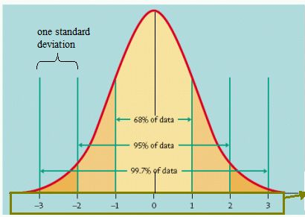
Variance
Recall that variance (or standard deviation) helped us predict how likely certain events are:
How do we know how variable a model’s accuracy is?

Slide 15
Variance
Recall that variance (or standard deviation) helped us predict how likely certain events are:
We need multiple accuracy scores! Ideas?

Slide 16
Repeated experimentation
Data
Label
Training data
0
0
1
Rather than just splitting once, split multiple times
Labeled data
1
0
1
Testing data
0

Slide 17
Repeated experimentation
Data
Label
Data
Label
Data
Label
0
0
0
0
0
0
1
1
1
Training data
…
1
1
1
0
0
0
1
1
1
= train
= development

Slide 18
n-fold cross validation
break into n
equal-size parts
repeat for all parts/splits: train on n-1 parts optimize on the other
Training data
…
…
…
…
split 1
split 2
split 3

Slide 19
n-fold cross validation
evaluate
score 1
…
score 2
split 1
…
score 3
split 2
…
…
…
split 3

Slide 20
n-fold cross validation
better utilization of labeled data
more robust: don’t just rely on one test/development set to evaluate the approach (or for optimizing parameters)
multiplies the computational overhead by n (have to train n models instead of just one)
10 is the most common choice of n

Slide 21
Leave-one-out cross validation
n-fold cross validation where n = number of examples
aka “jackknifing”
pros/cons?
when would we use this?

Slide 22
Leave-one-out cross validation
Can be very expensive if training is slow and/or if there are a large number of examples
Useful in domains with limited training data: maximizes the data we can use for training

Slide 23
Comparing systems: sample 1
split | model 1 | model 2
1 | 87 | 88
2 | 85 | 84
3 | 83 | 84
4 | 80 | 79
5 | 88 | 89
6 | 85 | 85
7 | 83 | 81
8 | 87 | 86
9 | 88 | 89
10 | 84 | 85
average: | 85 | 85
Is model 2 better than model 1?

Slide 24
Comparing systems: sample 2
split | model 1 | model 2
1 | 87 | 87
2 | 92 | 88
3 | 74 | 79
4 | 75 | 86
5 | 82 | 84
6 | 79 | 87
7 | 83 | 81
8 | 83 | 92
9 | 88 | 81
10 | 77 | 85
average: | 82 | 85
Is model 2 better than model 1?

Slide 25
Comparing systems: sample 3
split | model 1 | model 2
1 | 84 | 87
2 | 83 | 86
3 | 78 | 82
4 | 80 | 86
5 | 82 | 84
6 | 79 | 87
7 | 83 | 84
8 | 83 | 86
9 | 85 | 83
10 | 83 | 85
average: | 82 | 85
Is model 2 better than model 1?

Slide 26
Comparing systems
split | model 1 | model 2
1 | 84 | 87
2 | 83 | 86
3 | 78 | 82
4 | 80 | 86
5 | 82 | 84
6 | 79 | 87
7 | 83 | 84
8 | 83 | 86
9 | 85 | 83
10 | 83 | 85
average: | 82 | 85
split | model 1 | model 2
1 | 87 | 87
2 | 92 | 88
3 | 74 | 79
4 | 75 | 86
5 | 82 | 84
6 | 79 | 87
7 | 83 | 81
8 | 83 | 92
9 | 88 | 81
10 | 77 | 85
average: | 82 | 85
What’s the difference?

Slide 27
Comparing systems
split | model 1 | model 2
1 | 84 | 87
2 | 83 | 86
3 | 78 | 82
4 | 80 | 86
5 | 82 | 84
6 | 79 | 87
7 | 83 | 84
8 | 83 | 86
9 | 85 | 83
10 | 83 | 85
average: | 82 | 85
std dev | 2.3 | 1.7
split | model 1 | model 2
1 | 87 | 87
2 | 92 | 88
3 | 74 | 79
4 | 75 | 86
5 | 82 | 84
6 | 79 | 87
7 | 83 | 81
8 | 83 | 92
9 | 88 | 81
10 | 77 | 85
average: | 82 | 85
std dev | 5.9 | 3.9
Even though the averages are same, the variance is different!

Slide 28
Comparing systems: sample 4
split | model 1 | model 2
1 | 80 | 82
2 | 84 | 87
3 | 89 | 90
4 | 78 | 82
5 | 90 | 91
6 | 81 | 83
7 | 80 | 80
8 | 88 | 89
9 | 76 | 77
10 | 86 | 88
average: | 83 | 85
std dev | 4.9 | 4.7
Is model 2 better than model 1?

Slide 29
Comparing systems: sample 4
split | model 1 | model 2 | model 2 – model 1
1 | 80 | 82 | 2
2 | 84 | 87 | 3
3 | 89 | 90 | 1
4 | 78 | 82 | 4
5 | 90 | 91 | 1
6 | 81 | 83 | 2
7 | 80 | 80 | 0
8 | 88 | 89 | 1
9 | 76 | 77 | 1
10 | 86 | 88 | 2
average: | 83 | 85
std dev | 4.9 | 4.7
Is model 2 better than model 1?

Slide 30
Comparing systems: sample 4
split | model 1 | model 2 | model 2 – model 1
1 | 80 | 82 | 2
2 | 84 | 87 | 3
3 | 89 | 90 | 1
4 | 78 | 82 | 4
5 | 90 | 91 | 1
6 | 81 | 83 | 2
7 | 80 | 80 | 0
8 | 88 | 89 | 1
9 | 76 | 77 | 1
10 | 86 | 88 | 2
average: | 83 | 85
std dev | 4.9 | 4.7
Model 2 is ALWAYS better

Slide 31
Comparing systems: sample 4
split | model 1 | model 2 | model 2 – model 1
1 | 80 | 82 | 2
2 | 84 | 87 | 3
3 | 89 | 90 | 1
4 | 78 | 82 | 4
5 | 90 | 91 | 1
6 | 81 | 83 | 2
7 | 80 | 80 | 0
8 | 88 | 89 | 1
9 | 76 | 77 | 1
10 | 86 | 88 | 2
average: | 83 | 85
std dev | 4.9 | 4.7
How do we decide if model 2 is better than model 1?

Slide 32
Statistical tests
Setup:
Assume some default hypothesis about the data that you’d like to disprove, called the null hypothesis
e.g. model 1 and model 2 are not statistically different in performance
Test:
Calculate a test statistic from the data (often assuming something about the data)
Based on this statistic, with some probability we can reject the null hypothesis, that is, show that it does not hold

Slide 33
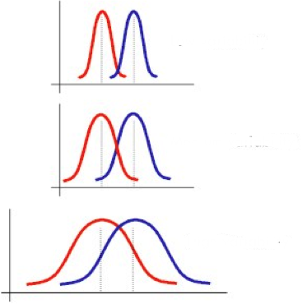
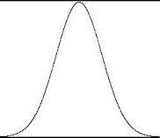
t-test
Determines whether two samples come from the same underlying distribution or not
?

Slide 34
t-test
Null hypothesis: model 1 and model 2 accuracies are no different, i.e. come from the same distribution
Assumptions: there are a number that often aren’t completely true, but we’re often not too far off
Result: probability that the difference in accuracies is due to random chance (low values are better)

Slide 35
Calculating t-test
For our setup, we’ll do what’s called a “pair t-test”
The values can be thought of as pairs, where they were calculated under the same conditions
In our case, the same train/test split
Gives more power than the unpaired t-test (we have more information)
For almost all experiments, we’ll do a “two-tailed” version of the t-test
Can calculate by hand or in code, but why reinvent the wheel: use excel or a statistical package
http://en.wikipedia.org/wiki/Student's_t-test
http://www.statskingdom.com/160MeanT2pair.html
https://www.socscistatistics.com/tests/ttestdependent/Default2.aspx

Slide 36
p-value
The result of a statistical test is often a p-value
p-value: the probability that the null hypothesis holds. Specifically, if we re-ran this experiment multiple times (say on different data) what is the probability that we would reject the null hypothesis incorrectly (i.e. the probability we’d be wrong)
Common values to consider “significant”: 0.05 (95% confident), 0.01 (99% confident) and 0.001 (99.9% confident)

Slide 37
Comparing systems: sample 1
split | model 1 | model 2
1 | 87 | 88
2 | 85 | 84
3 | 83 | 84
4 | 80 | 79
5 | 88 | 89
6 | 85 | 85
7 | 83 | 81
8 | 87 | 86
9 | 88 | 89
10 | 84 | 85
average: | 85 | 85
Is model 2 better than model 1?
They are the same with:
p = 1

Slide 38
Comparing systems: sample 2
split | model 1 | model 2
1 | 87 | 87
2 | 92 | 88
3 | 74 | 79
4 | 75 | 86
5 | 82 | 84
6 | 79 | 87
7 | 83 | 81
8 | 83 | 92
9 | 88 | 81
10 | 77 | 85
average: | 82 | 85
Is model 2 better than model 1?
They are the same with:
p = 0.15

Slide 39
Comparing systems: sample 3
split | model 1 | model 2
1 | 84 | 87
2 | 83 | 86
3 | 78 | 82
4 | 80 | 86
5 | 82 | 84
6 | 79 | 87
7 | 83 | 84
8 | 83 | 86
9 | 85 | 83
10 | 83 | 85
average: | 82 | 85
Is model 2 better than model 1?
They are the same with:
p = 0.007

Slide 40
Comparing systems: sample 4
split | model 1 | model 2
1 | 80 | 82
2 | 84 | 87
3 | 89 | 90
4 | 78 | 82
5 | 90 | 91
6 | 81 | 83
7 | 80 | 80
8 | 88 | 89
9 | 76 | 77
10 | 86 | 88
average: | 83 | 85
Is model 2 better than model 1?
They are the same with:
p = 0.001

Slide 41
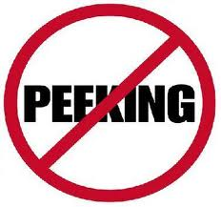
Statistical tests on test data
Training
Data
All Training
Data
Labeled
Data
Development
Data
Test
Data
cross-validation with t-test
(data with labels)
Can we do that here?
Notes:
No… the problem is that we only have one test set and we can’t resample, etc. because then we’ll have looked at the test data!

Slide 42
Bootstrap resampling
training set t with n samples
do m times:
sample n examples with replacement from the training set to create a new training set t’
train model(s) on t’
calculate performance on test set
calculate t-test (or other statistical test) on the collection of m results

Slide 43
Bootstrap resampling
Test
Data
sample with replacement
All
Training
Data
Sample
model
(data with labels)
evaluate
repeat m times to get m samples

Slide 44
Experimentation good practices
Never look at your test data!
During development
Compare different models/hyperparameters on development data
use cross-validation to get more consistent results
If you want to be confident with results, use a t-test and look for p = 0.05
For final evaluation, use bootstrap resampling combined with a t-test to compare final approaches

Slide 45
CSE419 – Artificial Intelligence and Machine Learning 2020 PhD Furkan Gözükara, Toros University https://github.com/FurkanGozukara/CSE419-Artificial-Intelligence-and-Machine-Learning-2020
Lecture 9 Part 2
Multiclass
Based on Asst. Prof. Dr. David Kauchak (Pomona College) Lecture Slides

Slide 46


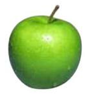
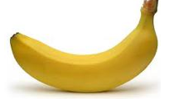


Multiclass classification
examples
label
Same setup where we have a set of features for each example
Rather than just two labels, now have 3 or more
apple
orange
apple
banana
real-world examples?
banana
pineapple

Slide 47
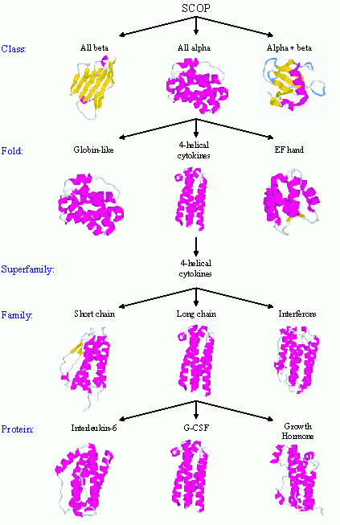
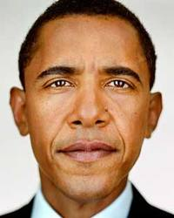

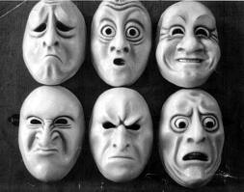

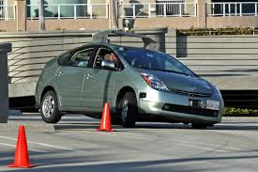
Real world multiclass classification
handwriting recognition
protein classification
face recognition
document classification
most real-world applications tend to be multiclass
emotion recognition
sentiment analysis
autonomous vehicles

Slide 48
Multiclass: current classifiers
Any of these work out of the box?
With small modifications?

Slide 49

k-Nearest Neighbor (k-NN)
To classify an example d:
Find k nearest neighbors of d
Choose as the label the majority label within the k nearest neighbors
No algorithmic changes!

Slide 50
Decision Tree learning
Base cases:
If all data belong to the same class, pick that label
If all the data have the same feature values, pick majority label
If we’re out of features to examine, pick majority label
If the we don’t have any data left, pick majority label of parent
If some other stopping criteria exists to avoid overfitting, pick majority label
Otherwise:
calculate the “score” for each feature if we used it to split the data
pick the feature with the highest score, partition the data based on that data value and call recursively
No algorithmic changes!

Slide 51
Perceptron learning
Hard to separate three classes with just one line ☹

Slide 52
Black box approach to multiclass
Abstraction: we have a generic binary classifier, how can we use it to solve our new problem
+1
binary classifier
optionally: also output a confidence/score
-1
Can we solve our multiclass problem with this?

Slide 53
Multiclass classification
examples
label
Same setup where we have a set of features for each example
Rather than just two labels, now have 3 or more
apple
orange
apple
banana
banana
pineapple

Slide 54
Black box approach to multiclass
Abstraction: we have a generic binary classifier, how can we use it to solve our new problem
+1
binary classifier
optionally: also output a confidence/score
-1
Can we solve our multiclass problem with this?

Slide 55
Approach 1: One vs. all (OVA)
Training: for each label L, pose as a binary problem
all examples with label L are positive
all other examples are negative
apple vs. not
orange vs. not
banana vs. not
apple
+1
-1
-1
orange
-1
+1
-1
apple
+1
-1
-1
banana
-1
-1
+1
banana
-1
-1
+1

Slide 56
OVA: linear classifiers (e.g. perceptron)
banana vs. not
pineapple vs. not
apple vs. not

Slide 57
OVA: linear classifiers (e.g. perceptron)
banana vs. not
pineapple vs. not
apple vs. not
How do we classify?

Slide 58
OVA: linear classifiers (e.g. perceptron)
banana vs. not
pineapple vs. not
apple vs. not
How do we classify?

Slide 59
OVA: linear classifiers (e.g. perceptron)
banana vs. not
pineapple vs. not
apple vs. not
How do we classify?

Slide 60
OVA: linear classifiers (e.g. perceptron)
banana vs. not
pineapple vs. not
apple vs. not
How do we classify?

Slide 61
OVA: linear classifiers (e.g. perceptron)
none?
banana OR pineapple
banana vs. not
pineapple vs. not
apple vs. not
How do we classify?

Slide 62
OVA: linear classifiers (e.g. perceptron)
banana vs. not
pineapple vs. not
apple vs. not
How do we classify?

Slide 63
OVA: classify
Classify:
If classifier doesn’t provide confidence (this is rare) and there is ambiguity, pick one of the ones in conflict
Otherwise:
pick the most confident positive
if none vote positive, pick least confident negative

Slide 64
OVA: linear classifiers (e.g. perceptron)
banana vs. not
pineapple vs. not
What does the decision boundary look like?
apple vs. not

Slide 65
OVA: linear classifiers (e.g. perceptron)
PINEAPPLE
APPLE
BANANA

Slide 66
OVA: classify, perceptron
Classify:
If classifier doesn’t provide confidence (this is rare) and there is ambiguity, pick majority in conflict
Otherwise:
pick the most confident positive
if none vote positive, pick least confident negative
How do we calculate this for the perceptron?

Slide 67
OVA: classify, perceptron
Classify:
If classifier doesn’t provide confidence (this is rare) and there is ambiguity, pick majority in conflict
Otherwise:
pick the most confident positive
if none vote positive, pick least confident negative
Distance from the hyperplane

Slide 68
Approach 2: All vs. all (AVA)
Training:
For each pair of labels, train a classifier to distinguish between them
for i = 1 to number of labels:
for k = i+1 to number of labels:
train a classifier to distinguish between label_{j} and label_{k}:
- create a dataset with all examples with label_{j} labeled positive and all examples with label_{k} labeled negative
- train classifier on this subset of the data

Slide 69
AVA training visualized
apple vs orange
orange vs banana
+1
apple
+1
-1
orange
+1
-1
-1
apple
apple vs banana
banana
+1
banana
+1
-1
-1

Slide 70

AVA classify
apple vs orange
+1
+1
orange vs banana
-1
+1
apple vs banana
-1
What class?
+1
-1
+1
-1
-1

Slide 71
AVA classify
apple vs orange
+1
orange
+1
orange vs banana
-1
+1
apple vs banana
orange
orange
-1
+1
-1
+1
apple
In general?
-1
-1

Slide 72
AVA classify
To classify example e, classify with each classifier f_{jk}
We have a few options to choose the final class:
Take a majority vote
Take a weighted vote based on confidence
y = f_{jk}(e)
score_{j} += y
score_{k} -= y
How does this work?
Here we’re assuming that y encompasses both the prediction (+1,-1) and the confidence, i.e. y = prediction * confidence.

Slide 73
AVA classify
Take a weighted vote based on confidence
y = f_{jk}(e)
score_{j} += y
score_{k} -= y
If y is positive, classifier thought it was of type j:
- raise the score for j
- lower the score for k
if y is negative, classifier thought it was of type k:
- lower the score for j
- raise the score for k

Slide 74
OVA vs. AVA
Train/classify runtime?
Error? Assume each binary classifier makes an error with probability ε

Slide 75
OVA vs. AVA
Train time:
AVA learns more classifiers, however, they’re trained on much smaller data this tends to make it faster if the labels are equally balanced
Test time:
AVA has more classifiers
Error (see the book for more justification):
AVA trains on more balanced data sets
AVA tests with more classifiers and therefore has more chances for errors
- Theoretically:
-- OVA: ε (number of labels -1)
-- AVA: 2 ε (number of labels -1)

Slide 76
Approach 3: Divide and conquer
vs
vs
vs
Pros/cons vs. AVA?
Notes:
less classifiers during training
less classifiers to make a mistake during testing
have to choose with examples to group together (and this can impact performance)

Slide 77
Multiclass summary
If using a binary classifier, the most common thing to do is OVA
Otherwise, use a classifier that allows for multiple labels:
DT and k-NN work reasonably well
We’ll see a few more in the coming weeks that will often work better

Slide 78
Multiclass evaluation
label
prediction
apple
orange
orange
orange
How should we evaluate?
apple
apple
banana
pineapple
banana
banana
pineapple
pineapple

Slide 79
Multiclass evaluation
label
prediction
apple
orange
orange
orange
Accuracy: 4/6
apple
apple
banana
pineapple
banana
banana
pineapple
pineapple

Slide 80
Multiclass evaluation imbalanced data
label
prediction
apple
orange
…
Any problems?
apple
apple
banana
pineapple
Data imbalance!
banana
banana
pineapple
pineapple
Notes:
- could try and do precision/recall for each class, but there can be lots of classes

Slide 81
Macroaveraging vs. microaveraging
microaveraging: average over examples (this is the “normal” way of calculating)
macroaveraging: calculate evaluation score (e.g. accuracy) for each label, then average over labels
What effect does this have?
Why include it?

Slide 82
Macroaveraging vs. microaveraging
microaveraging: average over examples (this is the “normal” way of calculating)
macroaveraging: calculate evaluation score (e.g. accuracy) for each label, then average over labels
Puts more weight/emphasis on rarer labels
Allows another dimension of analysis

Slide 83
Macroaveraging vs. microaveraging
label
prediction
microaveraging: average over examples
macroaveraging: calculate evaluation score (e.g. accuracy) for each label, then average over labels
apple
orange
orange
orange
apple
apple
banana
pineapple
banana
banana
pineapple
pineapple

Slide 84
Macroaveraging vs. microaveraging
label
prediction
microaveraging: 4/6
macroaveraging:
apple = 1/2
orange = 1/1
banana = 1/2
pineapple = 1/1
total = (1/2 + 1 + 1/2 + 1)/4
= 3/4
apple
orange
orange
orange
apple
apple
banana
pineapple
banana
banana
pineapple
pineapple

Slide 85
Confusion matrix
entry (i, j) represents the number of examples with label i that were predicted to have label j
another way to understand both the data and the classifier
 | Classic | Country | Disco | Hiphop | Jazz | Rock
Classic | 86 | 2 | 0 | 4 | 18 | 1
Country | 1 | 57 | 5 | 1 | 12 | 13
Disco | 0 | 6 | 55 | 4 | 0 | 5
Hiphop | 0 | 15 | 28 | 90 | 4 | 18
Jazz | 7 | 1 | 0 | 0 | 37 | 12
Rock | 6 | 19 | 11 | 0 | 27 | 48
Notes:
what do the entries along the diagonal represent?

Slide 86
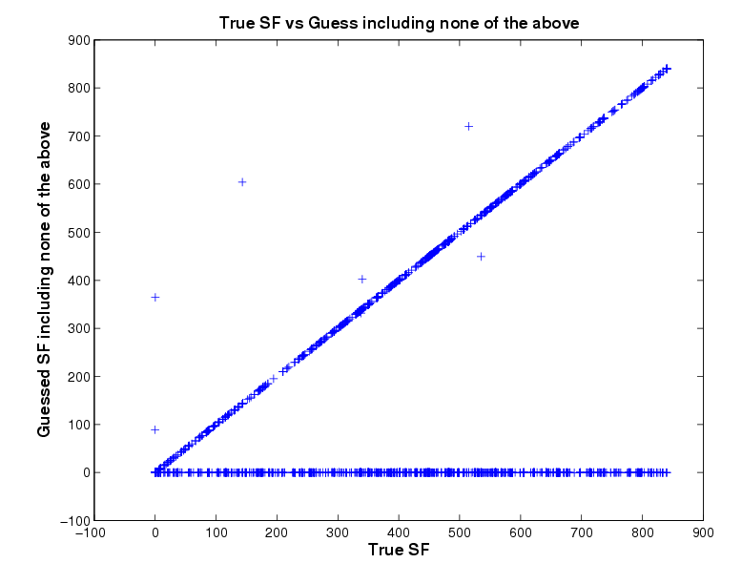
Confusion matrix
BLAST classification of proteins in 850 superfamilies

Slide 87
Multilabel vs. multiclass classification
Is it edible?
Is it sweet?
Is it a fruit?
Is it a banana?
Is it a banana?
Is it an apple?
Is it an orange?
Is it a pineapple?
Is it a banana?
Is it yellow?
Is it sweet?
Is it round?
Any difference in these labels/categories?

Slide 88
Multilabel vs. multiclass classification
Is it edible?
Is it sweet?
Is it a fruit?
Is it a banana?
Is it a banana?
Is it an apple?
Is it an orange?
Is it a pineapple?
Is it a banana?
Is it yellow?
Is it sweet?
Is it round?
Different structures
Nested/ Hierarchical
Exclusive/ Multiclass
General/Structured

Slide 89
Multiclass vs. multilabel
Multiclass: each example has one label and exactly one label
Multilabel: each example has zero or more labels. Also called annotation
Multilabel applications?

Slide 90
Multilabel
Image annotation
Document topics
Labeling people in a picture
Medical diagnosis

Slide 91
Multiclass vs. multilabel
Multiclass: each example has one label and exactly one label
Multilabel: each example has zero or more labels. Also called annotation
Which of our approaches work for multilabel?

